Slide 1
Introduction to OS-Climate
Onboarding Materials

Slide 2
Table of Contents
OS-Climate Platform Overview
Community Structure and Leadership
Member Contributions
OS-Climate Policies
Meetings, Meeting Notes and Mailing Lists
Resources for First Time Open Source Contributors
Workstream-Specific Materials
Data Commons
Data Governance
Data Management
Natural Language Processing (NLP)
Entity Matching
Implied Temperature Rise (ITR)
Physical Risk
Transition Risk
Appendix

Slide 3
OS-Climate Platform Overview

Slide 4
OS-Climate Approach
Applying the community-based open-source approach that has enabled breakthroughs in Life Sciences & Tech to solve data & analytics challenges required for investment to achieve Paris Climate Accord goals
OPEN SOURCE COMMUNITY
GLOBAL DATA COMMONS
ANALYTIC TOOLS
Governance, licensing, and collaboration structures enabling stakeholders to share cost, intellectual property, and effort.
Joint projects for new data, modelling, standards, and supporting technology
Curated library of public and private sources, for both transition and physical risk/opportunity
More accurate corporate historical and forward-looking climate & ESG metrics as a public good
Integrate climate-related risk and opportunity into decisions by investors, financial institutions, regulators, etc.
Top-down and bottom-up modelling
Scenario analysis tools
Alignment tools

Slide 5
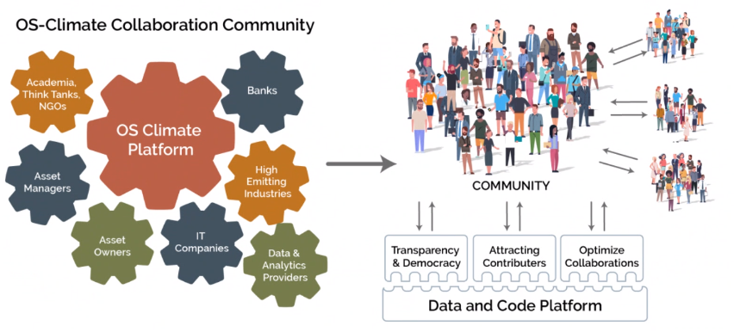
Why OS-Climate is a game-changer

Slide 6
Planned OS-Climate Platform components
Data Commons
Corporate
Data
Economic, Market Data
Sector & Industry Data
Policy & Technology Data
Physical Risk Data
Linkage & Asset-Level Data
Scenarios
Tools for Scenario Analysis & Alignment
Transition Scenario Analysis
Target-Setting and Alignment
Physical Risk
Top-Down
Portfolio Analysis
Bottom-Up
Company & Security Analysis
Stress Testing

Slide 7
OS-C components and workstreams
Portfolio Alignment,
Physical Risk &
Transition Analysis
Extreme Events
Portfolio Assets
Vulnerability models
Interfaces
Financial
&
Climate Impact
Infrastructure
Corporate Emissions
Targets
Progress Metrics
Climate Models
Energy System Model
Economic Models
Platform & Tooling
Data commons
functionality
Data availability (hazard, asset, financial)
Data security, quality & accuracy
Data comparability
Data exports
Data Management Platform
Data commons
data types (e.g.,
counterparty/
corporates)
Entity Matching
Assets
Emissions, Targets, Progress
Other
Data Science & Analytics Platform
Data sources (Public/Proprietary/Metadata): Federated, Uploaded, & Derived

Slide 8




OS-Climate Platform end-to-end system flow
Data Categories
Federated Governance
Standards & Frameworks Include
Corporate data
Economic data
Market data
Sector data
Industry data
Policy data
Technology data
Physical data
Linkage & Asset-Level data
Scenario data
Scope 3 data
Analytic Tools Generating Data for Investment & Finance Processes
DATA DOMAIN 1
DATA DOMAIN 3
ISSB
Ingestion
Processing
Destination
Ingestion
Processing
Destination
Target Setting and Alignment
Source System Protocol
DATA DOMAIN 2
DATA DOMAIN 4
Open Standard Protocol
Ingestion
Processing
Destination
Ingestion
Processing
Destination
Physical Risk Models
Self-Service Data Management Platform
Transition Scenario Analysis
Potential Users Include
GFANZ Alliance Members
CA100+
Counter-parties
NGOs & Researchers
Policymakers & Regulators

Slide 9
Focus users, tools, and use cases in 2021–2022
Asset Owners, Asset Managers, Banks & Regulators
2021: Portfolio Alignment Tool (ITR; in 2022, adding Emissions & Capacity-Based)
2021: Physical Risk Tool
2022: Scenario Analysis (Risk & Opportunity)
Stress testing
Risk management
Asset allocation
Portfolio construction
Research (investment, banking, etc.)
Manager selection
Analysis of securities & loans
Design and execution of benchmarks, strategies & products
Disclosure & reporting
Engagement with companies & financial institutions
The OS-C Platform also will help Corporates efficiently disclose climate & ESG data while building a library of trustworthy data, available to the public at no cost.

Slide 10
Community Structure and Leadership

Slide 11


















Our Members & Initial Contributing Partners
PREMIUM MEMBERS
GENERAL MEMBERS
DATA AND MODEL PARTNERS
World Resources Institute
Notes:
Break out - Premium and general members – drop IDS

Slide 12
Governance structure and business model
GOVERNING BOARD
TECHNICAL ADVISORY
COUNCIL
SERIES LLC
SERIES LLC
SERIES LLC
PROJECT ABC
Technical Steering Committee
PROJECT DEF
Technical Steering Committee
...PROJECT XYZ
Technical Steering Committee
OUTREACH
LEGAL
BUDGET
DEV
COMMUNITY
DATA COMMUNITY
DEV + DATA
COMMUNITY
Business model: non-profit 501(c)(6) business association under the Linux Foundation (largest organizer of open-source tech initiatives globally); platform management and development funded by annual member fees plus philanthropic grants.
Governing Board (fee-paying members + Academia, IGO, NGO) decides strategy, priorities, & budget. In Year 1, Asset Owners, Asset Managers, & Banks will be the majority and set direction.
Technical Advisory Council (TAC) sets technical vision, facilitates collaboration among the Technical Projects, and recommends budget and technical decisions to Board.
Technical Steering Committees (TSCs) is responsible for technical oversight of each Project.
10

Slide 13
Community Leadership
Rim Tehraoui, BNP Paribas (Board Chair)
Thierry Chevalier, Airbus
Remco Fischer, UNEP-FI, Net Zero Asset Owner Alliance Secretariat
Adam Levy, KPMG
Udo Riese, Allianz
Truman Semans, OS-C Core Team
Tim Whitehead Goldman Sachs
Governing Board Members
Truman Semans, Founder & CEO
Heather Ackenhusen, Technical Program
Manager
Michael Tiemann, Project Leader
Ava Houck, Community Manager
Core Team
Frances Barney, BNY Mellon
Xiaochen Zhang, Amazon
Lisa Eichler, Ortec Finance
Daniel Godfrey, Federated Hermes
Richard Harmon, Red Hat
David Harris, London Stock Exchange Group
James Salo, S&P Global
Brandon Sutcliffe, EY
Nicolas Schifano, Microsoft
Governing Board Observers
Vincent Caldeira, Red Hat
Matthieu Meaux, Airbus
Robert Moroney, KPMG
Abhishek Narang, Goldman Sachs
Ludan Stoeckle, BNP Paribas
Technical Advisory Council

Slide 14
Project Leadership and Advisors
Data Commons
Architecture/Infrastructure
Vincent Caldeira, Red Hat
Erik Erlandson, Red Hat
Madhu Bussa, AWS
Data Management
Thomas Kirchherr, IDS GmbH
Data Governance:
Heather Ackenhusen, OS-C
Data Extraction & Natural Language Processing: (NLP)
Lea Deleris, BNP Paribas
Jeremy Goh, BNP Paribas
Christian Meyndt, IDS GmbH
Entity Matching:
Tu Schmucker, Allianz
Ludan Stoeckle, BNP Paribas
Implied Temperature Rise Alignment Tool
Monique Barbut
Lionel Johnson
Bob Litterman
Ria Persad
Deborah Spalding
Jim Whitehurst
Leyla Javadova, Allianz
Roland Oehen-Kanzow, Metafinanz
Franz Croonenbrock, Metafinanz
Senior Advisors
Physical Risk Tool
Matt Sandoe, BNP Paribas
Joe Moorehouse, BNP Paribas
Scientific Advisory Council
Ana Pinheiro Privette. Amazon
Amy Luers, Microsoft
Transition Risk
Thierry Chevalier, Airbus
Matthieu Meaux, Airbus

Slide 15
Member Contributions

Slide 16
Member Contributions
Aside from membership fees and participation in project governance, there are no contractually required commitments for members.
The Community of members expects that all members will contribute intellectual property and substantial effort from technical and project management
Areas of expected contribution:
Platform organization and development workstreams and tasks aligning with member priorities
Marketing and PR to increase of the influence and member base of the project
There is no one-size-fits-all, and members' contributions naturally will evolve over time.

Slide 17
Member Contributions: Intellectual Property
Members are expected to contribute on an open source basis the code that their technical staff write as part of OS-Climate projects and workstreams.
The Linux Foundation can provide resources to support members for readiness to engage in open source projects, such as the formation of open sources offices, education of in-house counsel on legal issues related to open source and of members’ IT organizations on security and related considerations.
Members are encouraged to contribute existing code and data assets to the community, either for existing projects and workstreams or, in the case of large scale contributions, as a new technical project of OS-Climate (subject to agreement of the Technical Advisory Council and Governing Board).

Slide 18
Member Contributions: Technical Contributions
Members are asked to contribute substantial time from project managers, data scientists, and/or engineers for development of the OS-Climate Platform (Data Commons and its subsidiary workstreams, and analytic tools projects).
A key part of new member onboarding is dialogue to identify OS-C workstreams that align with a member’s own priorities, and to identify % FTEs of specific people the member will commit for specific contributions.
Note that most of the workstreams are for technical development or directly supporting technical development (such as Data Governance, Administration), but a few are for organizational development and advisory capacity.
OS-Climate experience to date with member technical contributors shows that the first 10%-15% of an FTE is just keeping up with the project, meaning that 20% FTEs deliver very little actual productive work. >30% FTEs can be useful contributors. 50%+ FTEs are able to make substantial contributions.
These are general guidelines; in projects and workstreams with well scoped roadmaps and strong project managers, smaller % FTE contributions can be effective.

Slide 19
Member Contributions: Project Governance
For Premium members, the baseline Governing Board member time commitment is ~4 hours per month for Board meetings and document review/feedback, plus some time for emails and periodic brief phone calls.
This will increase slightly in form Finance, Marketing, and Legal Committees starting in 2022.
Add some time for members taking on a Board or committee leadership role.
Baseline TAC time is ~4 hours per month for TAC meetings and document review/feedback, +1-2 hours for Chair;
The TAC role is likely to grow in 2022 if the TAC decides to take on an expanded community leadership role, as some TACs do.
For General members, for those wishing to be active Board Observers (at least for 2021, when all Board meetings are open to Board Observers), or if elected to represent a cohort of 4 General members, time demand similar to baseline time for Premium members.
Primary Point of Contact (typically your organization’s Board Member or Observer): 2-4 hours the first month for Onboarding, ~1-2 hours per month thereafter connecting OS-C community with staff and vice versa.

Slide 20
Member Contributions: Marketing and PR
All members are asked to:
Provide a communications point of contact for OS-Climate, and inform OS-Climate of other marketing and communications staff to keep informed.
We encourage members to nominate a member for the Outreach Committee (will start in 2022)
Premium members may name a person to the Committee, other nominations will be considered and decided by the Board.
Create speaking opportunities for OS-C (either Core team or other members) through their events and event sponsorships
Promote OS-C through their own speakers, social media, and other communications.

Slide 21
Member Contributions: Subject Matter Experts (SMEs)
In some circumstances, experts can make meaningful contributions to projects and workstreams
for example on assessing and deciding which methodological approaches to implement in modeling.
It is understood that many SMEs in the community will engage in large part for learning from peers, which is welcome. However, all SMEs are encouraged to make specific contributions that advance technical development of the Platform, or to actively contribute time for leadership or support to non-technical workstreams (e.g., Data Governance).

Slide 22
OS-Climate Policies

Slide 23
OS-Climate Policies
OS-Climate abides by all of the following Linux Foundation policies:
https://www.linuxfoundation.org/policies/
Members are expected to adhere to the following agreements signed at the onset of their membership:
OS-Climate Participation Agreement
Linux Foundation Membership Agreement
All community members are expected to abide by the LF Projects Code of Conduct
https://lfprojects.org/policies/code-of-conduct/
All project contributors are expected to adhere to the Linux Foundation DCO Policy
https://wiki.linuxfoundation.org/dco

Slide 24
Meetings, Meeting Notes, and Mailing Lists

Slide 25
All-Hands Meeting and Workstream Updates
Community Calendar (Meetings & Events): https://west.exch092.serverdata.net/owa/calendar/f55f275b1e724cc49b5a52f50c30a11f@os-climate.org/022d1c0017744eebbf9f14f737493bd67046415453482209411/calendar.html
We recommend bookmarking the link in your web browser; however, you can also find the calendar in GitHub (https://github.com/os-climate/OS-Climate-Community-Hub)
Note: you are welcome to attend any of our community meetings (access info is viewable in the calendar); however, if you want an invite to a particular meeting and did not receive one, please contact admin@os-climate.org.
All Community Members are encouraged to attend our Biweekly All-Hands meetings for brief Workstream and Community updates as well as demos where teams present their latest enhancements.
These meetings are held the 1st and 3rd Tuesday of each month from 10:30 - 11 am ET
All Community Members are invited to attend any of the following workstream meetings that are of interest:
Data Commons Tech Check-In
Weekly: Thursday 10 - 10:30 am ET
Physical Risk Tech Check-In
Weekly: Thursday 11:30 am - 12 pm ET
ITR Sync Meetings
Weekly: Monday 10 - 10:30 am ET
Natural Language Processing (NLP) Weekly Update
Weekly: Wednesday 10:30 - 11:00 am ET
Data Governance and Management
Weekly: Monday 8:30 - 9 am ET
Entity Matching
Bi-Weekly: Thursday 11:00 am - 11:30 am ET
Transition Analysis
Weekly: Wednesday 10 - 10:30 am ET

Slide 26
Data Commons Office Hours
In addition to the All-Hands meetings and Workstream Updates mentioned in the previous slides, all Community Members are invited to attend our Data Commons Office Hours where our technical leads will be available to answer questions and assist with any issues that arise within the Data Commons workstream.
These meetings are held weekly on Tuesdays and Fridays from 10 - 11 am ET
Meetings on the 1st and 3rd Tuesdays of each month are condensed to 10 - 10:30 am ET to accommodate the All-Hands meetings

Slide 27
Governing Board and TAC Meetings
OS-Climate Governing Board meetings are open only to Members of the Governing Board and the OS-Climate Core Team
Board Observers may also be included at the discretion of the Board Chair
These meetings are held the 3rd Wednesday of each month from 11 am - 12 pm ET
OS-Climate TAC Meetings are open only to members of the Technical Advisory Council and the Governing Board Members
These meetings are held the 2nd Monday of each month from 9 - 10 am ET

Slide 28
Signing Up for Slack & Mailing Lists
OS-Climate uses Slack as well as mailing lists to communicate project updates and workstream meeting links to our community members
To join Slack, os-climate.slack.com: click here
To subscribe to any of the OS-Climate mailing lists:
Send an email to <listname>+subscribe@lists.os-climate.org where <listname> is the name of the list you want to join.
(e.g. TransitionRisk+subscribe@lists.os-climate.org).
You can unsubscribe at any time by sending an email to <listname>+unsubscribe@lists.os-climate.org
Please note: you can also set personal preferences on how to receive updates (e.g. individual messages, daily summary, access messages via the website (receive no email), etc.).
If you have any questions/concerns, please contact Heather Ackenhusen (hackenhusen@os-climate.org).
See the following slide for a list of OS-Climate Mailing lists and their descriptions

Slide 29
All OS-Climate Mailing Lists
PhysicalRisk@lists.os-climate.org: Used to discuss requirements, development, testing, and implementation of the Physical Risk tool - the hazard and vulnerability risk models, plug & play model functionality and methodology to assess asset impact, including data visualization and economic risk.
PortfolioAlignment@lists.os-climate.org: Used to discuss requirements, development, testing, and implementation of the Implied Temperature Rise tool (ITR) along with other portfolio alignment tools - includes models, methodology, key data elements and visualization.
TransitionRisk@lists.os-climate.org: Used to discuss requirements, development, testing, and implementation of the Transition Risk tool with a focus on energy and economy models using SOSTrades/Witness.
EntityMatching@lists.os-climate.org: Used to discuss requirements, development, and testing to link key datasets to financial entities and regulatory standards, includes GLEIF, LEI, etc.
DataCommons@lists.os-climate.org: Used to discuss work on the platform, including: build out of architecture, data vault implementation, use of tech infrastructure (e.g. Trino), metadata, data lineage, data ingestion pipelines/processes, etc.
DataExtraction@lists.os-climate.org: Used to discuss work on the suite of tools used to extract data from non-standard formats(e.g. pdf reports) using NLP tools (ML and rules-based engines). Also the forum to discuss corporate data collection and topics like counterparty data models.
Developers@lists.os-climate.org: Used to inform OS-C GitHub users (developers, prod mgrs, proj mgrs) about key system enhancements, architecture changes, system maintenance, modified security/license processes, etc.

Slide 30
Accessing Meeting Notes and Meeting Recordings
All Hands and Workstream/Project meeting recordings can be found in the following folder on our Sharepoint Communications Page:
https://osclimateorg.sharepoint.com/:f:/g/EtcmK3lw5w5MqzlH_abAahgBupYIQ0bd9_hYqADx_yDtlg?e=fugKiv
To protect member’s privacy, meeting recording links are password protected
See the Book.xlsx file in the meeting recordings folder for password info
TAC and Governing Board meeting notes can be found in the following folder on our Sharepoint Communications Page

Slide 31
Resources for First Time Open Source Contributors

Slide 32
Intro to Open-Source Resources
For general Guidance on participating in an open-source project: http://theopensourceway.org/
Overview
Video: https://osclimateorg.sharepoint.com/:v:/g/EWCZiRHyyX5PrAfLtB4kNrkB2Wq7N-gO0UEwImceYHaRrg?e=bMwdtL
Presentation: https://osclimateorg.sharepoint.com/:b:/g/ETb2lsvJ2yZFhlloUEGalSUBBwR3OSlk1AUjJnQeSxNfBA?e=XQE9bK
Dev Ops Best Practices
Video: https://osclimateorg.sharepoint.com/:v:/g/EUeiDhnMLb9Lsk5SyvvCWHsBh6nPjRyly-qCKN8-6K0AMA?e=wE0Afs
Presentation: https://osclimateorg.sharepoint.com/:b:/g/Ed9eFTip1X1Eh3EhkRI25VEBOcOC7sZSas9iZFHwZvspKA?e=Bx5dhL
For guidance on how to make a pull request in github visit:
https://yourfirstpr.github.io/
For information on open-source license compliance
Blog: https://www.finos.org/blog/announcing-the-open-source-license-compliance-handbook
Handbook: https://www.finos.org/open-source-license-compliance-handbook-download-page?hs_preview=nOUxUYUU-7982450440&hsLang=en-us
Other best practices
https://www.finos.org/open-source-readiness
+ Additional resources from Red Hat

Slide 33
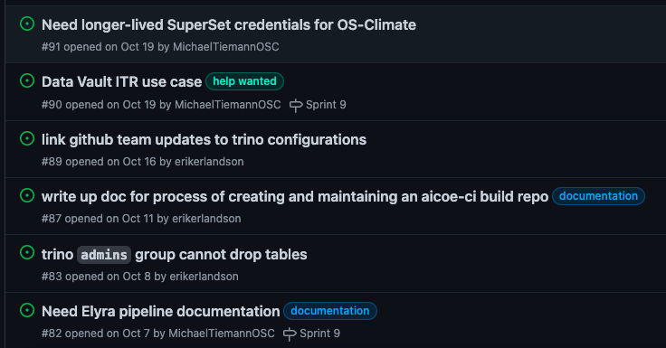
Where to Look for Issues
To start contributing to the Data Commons workstream visit https://github.com/os-climate/os_c_data_commons/issues
Find labels like:
Starter
Good first bug
low hanging fruit
help wanted

Slide 34
Data Commons Workstream

Slide 35
Data Commons Overview
A core goal of the Data Commons is to establish a publicly available database of all corporate voluntary and regulatory climate disclosures as well as reliable estimated data for companies that do not disclose, through advanced AI.
The Data Commons will combine federation from other existing sources with direct capture, cleanup, and storage of data in several domains.
The Commons will also cover data on climate scenarios, sectors and industries, policy, technology, corporate and public sector physical assets, linkage of these to companies and financial instruments, and other physical data (climate and weather, biodiversity and other natural capital, etc.)
For a high-level overview of the Data Commons use cases and architecture, see the following presentation from our COP26 launch event:
https://vimeo.com/658789631
For a more detailed overview of the Data Commons components, including data management and architecture, see the following presentation from our Technical Deep Dive Sessions:
https://vimeo.com/652668433
For additional resources on the Data Commons architecture and use cases, see the Data Commons appendix slides

Slide 36
Data Commons Workstream Orientation
Join the os-climate organization on Github
This is currently a private repository for members only - Michael Tiemann (mtiemann@os-climate.org) or Heather Ackenhusen (hackenhusen@os-climate.org) must invite new members
Our organization will be opened to the public in 2022 Q1 when we shift to full open source
Review the Data Commons README for a description of the project
Review the Data Commons Architecture Blueprint
Use the OS-Climate Data Commons Developer Guide as a tutorial resource for the following tasks:
Setting up your initial environment
Explore notebooks and manage dependencies
Push changes to GitHub
Setup pipelines to create releases, build images and enable dependency management
Create a Data Ingestion Pipeline
Create a Data Processing Pipeline
Setup and Deploy Inference Application
Test Deployed inference application
Monitor your inference application deployed
Review the Data Commons LICENSE documentation (Apache 2.0)
Members can subscribe to a list by sending an email to: DataCommons+subscribe@lists.os-climate.org and Developers+subscribe@lists.os-climate.org
Email admin@os-climate.org to be added to the following meetings:
Data Commons Weekly Tech Check-ins: Thursdays @ 10 - 10:30 am ET
Data Commons Daily Office hours: Tuesdays and Fridays @ 10 - 11 am ET

Slide 37
How to Participate in a Sprint
To participate in a Data Commons Sprint
Find an issue labeled “ starter”, “beginner”, “good-first-bug”, “help-wanted”
Visit the Data Commons Sprint Board and pick up the issue from the backlog and begin work
For updates on the status of sprints and progress on other issues, visit the Data Commons Tech Check-In Meetings Thursdays from 10:00 - 10:30 am ET
If you have any questions or run into any roadblocks, join the Data Commons office Hours Tuesdays and Fridays from 10:00 - 11:00 am ET

Slide 38
Data Commons Subworkstreams
The Data Commons workstream is supported by the following subworkstreams:
Data Governance & Management:
Establish data governance framework, including implementing processes to manage data quality, data issues, identify data owners, build a data catalog, create reference data and master data, protect data privacy, enforce and monitor data policies, provision and deliver data.
Data Extraction/AI using Natural Language Processing (NLP):
Build AI/ML-based and rules-based engines to extract critical ESG data from non-standardized reports to support portfolio alignment and physical risk tools.
For additional background on this workstream, see the following recording:
https://vimeo.com/652668377
To participate in the NLP workstream, email: DataExtraction+subscribe@lists.os-climate.org and Developers+subscribe@lists.os-climate.org
Workstream meetings are held weekly on Wednesdays from 10:30 - 11 am ET
Entity Matching:
Derive meaning from data by linking it with company entities (parent, subsidiary, etc.)
For additional background on the Entity Matching workstream, see the following recording:
https://vimeo.com/652693155
To participate in the Entity Matching workstream, email: EntityMatching+subscribe@lists.os-climate.org: and Developers+subscribe@lists.os-climate.org
Meeting time TBD

Slide 39
Implied Temperature Rise (ITR) Workstream

Slide 40

ITR—first of OS-C portfolio alignment methodologies
An open source ITR model that is transparent, dynamic, and science-based
Sector coverage
Climate Scenarios
Data Input
Issuer ISIN, region, industry, EVIC
Issuer climate reduction targets
Issuer scope 1 and 2 emissions
Issuer production values
Historic emission and production values
OECM 1.5° C
TPI 2°C
TPI below 2° C
Oil & Gas
Automobiles
Steel
Data Contributors
Electric Utilities
Scope 3 emissions to be onboarded going forward

Slide 41
ITR—calculation process
An open-source ITR model that is transparent, dynamic, and science-based
Step 1
Step 2
Step 3
Step 4
Step 5
Step 6
2020–2050 projected emission intensity trajectory of every company
Calculation of trajectory overshoot ratio
Trajectory temperature Score
Projected cumulative company emissions based on
1. Trajectory
2. Budget
3. Targets
WATS¹
2020–2050 projected emission intensities based on targets of every company
Measurement of alignment/misalignment to a selected climate scenario pathway
50% weight (adjustable)
Final ITR Score per company
ECOTS²
50% weight (adjustable)
TETS³
2020–2050 projected emission intensities based on industry budgets
Calculation of target overshoot ratio
Target temperature score
Notes:
steps fly in - use existing animation

Slide 42
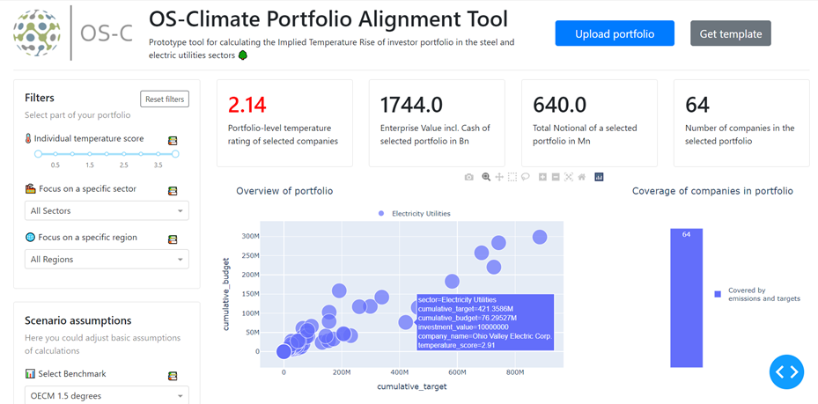

ITR reporting functionalities

Slide 43
ITR Workstream Overview
Leyla’s Methodology Handbook in Jan 2022
Joris’s tool design slides

Slide 44
Placeholder for Tool Design
Ask Joris to upload slides to Github and then include a link in this deck

Slide 45
How to Participate in ITR Workstream
visit https://github.com/orgs/os-climate/projects/3 for project dashboard
For any questions or to get started with a task, attend the ITR Sync Meetings - TBD

Slide 46
Physical Risk Workstream
Overview & Technical Demo

Slide 47
Physical risk
Innovation through collaboration
BASELINE BUILDING BLOCKS FOR PHYSICAL RISK MEASUREMENT
CLIMATE HAZARDS
Selecting hazards, models and time horizons
PHYSICAL RISK
VULNERABILITIES (Sensitivities)
ASSET DATA (Exposure)
Identifying asset exposure by mapping onto hazard spatial model
Applying vulnerability factors
Notes:
To measure physical risk, three key elements are required.
Firstly a climate hazard model which defines climate hazards (models for wildfire, water stress, sea level, heatwave, cold wave, flood, hurricane/wind…⁾across grid map references.
Secondly, the mapping of an asset to its specific geo-located hazard (Data which allows identification of the asset and longitude and latitude information is mapped onto the climate hazards.
Thirdly, a modelling of the vulnerability of the asset in order to assess the impact the hazard could have on it. Applying an understanding of exposure company has through its labour & Water sensitivity (revenues) and Capital sensitivity (asset value damage)

Slide 48
Physical risk modelling framework
HAZARD DATA SETS
(wind speed, temperature, precipitation... on a latitude/longitude grid for each scenario)
Frequency and Severity (distribution—uncertain)
HAZARDS
ASSET IMPACT DISTRIBUTION
ASSET DATA SET
(location, type, and characteristics)
Vulnerability to events
(distribution—uncertain)
ASSETS
RISK MODEL
EXPOSURE/VULNERABILITY MODEL
FINANCIAL DATA SET
(exposure to assets, financials, credit risk)
COMPANY
Notes:
Ecosystem of models; the model-owner defines the appropriate combination of models
Hazard models
Exposure/vulnerability models
Financial models
Probabilistic approach to capture sources of uncertainty, aleatory and epistemic
Transparency of methods

Slide 49
Transition Risk Workstream
Overview & Technical Demo

Slide 50
Data Extraction/AI (ML and rules based engine for NLP)
Overview & Technical Demo

Slide 51
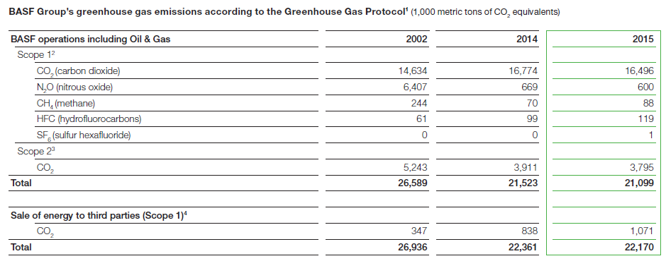
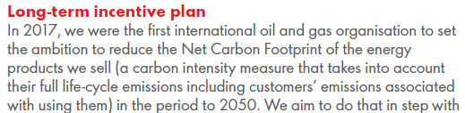
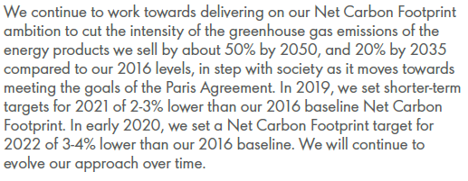
Sourcing ESG data using natural language processing
Input: Unstructured Data (PDF Report)
BASF
Shell
Notes:
3 bullet points of what is being done during NLP process: (1) insufficient data found in corp reports (2) allianz open sourced methodology to extract key data from unstructured data

Slide 52
Sourcing ESG data using natural language processing
Input: Unstructured Data (PDF Report)
Output: Extracted KPIs (e.g., CSV-file)
BASF
KPI_ID | KPI_NAME | VALUE | PAGE_NUM
6 | Scope 1/Direct total GHGs emissions | 347 | 122
6 | Scope 1/Direct total GHGs emissions | 838 | 122
6 | Scope 1/Direct total GHGs emissions | 1,071 | 122
7 | Scope 2 Energy indirect total GHGs emissions | 5,243 | 122
7 | Scope 2 Energy indirect total GHGs emissions | 3,911 | 122
7 | Scope 2 Energy indirect total GHGs emissions | 3,795 | 122
12 | Target in percent (climate commitment) | half | 44
12 | Target in percent (climate commitment) | half | 42
12 | Target in percent (climate commitment) | half | 78
12 | Target in percent (climate commitment) | 50% | 4
11 | Target year (climate commitment) | 2050 | 17
ML/NLP
Process
Shell
Note: There are more columns, but not shown here for simplicity
Notes:
3 bullet points of what is being done during NLP process: (1) insufficient data found in corp reports (2) allianz open sourced methodology to extract key data from unstructured data

Slide 53
Additional Questions?
Contact admin@os-climate.org

